Slide 1
Competitive Programming
18 Aug. 2023
Andrei Novikov

Slide 2
Concurrency
C++ synchronization primitives:
Mutex (std::mutex)
Condition Variable (std::condition_variable)
Semaphores (std::counting_semaphore)
Python
Mutex (threading.Lock, threading. RLock)
Condition Variable (threading.Condition)
Semaphores (threading.Semaphore)
Is not supported by clang compiler that is used by Leetcode yet.

Slide 3
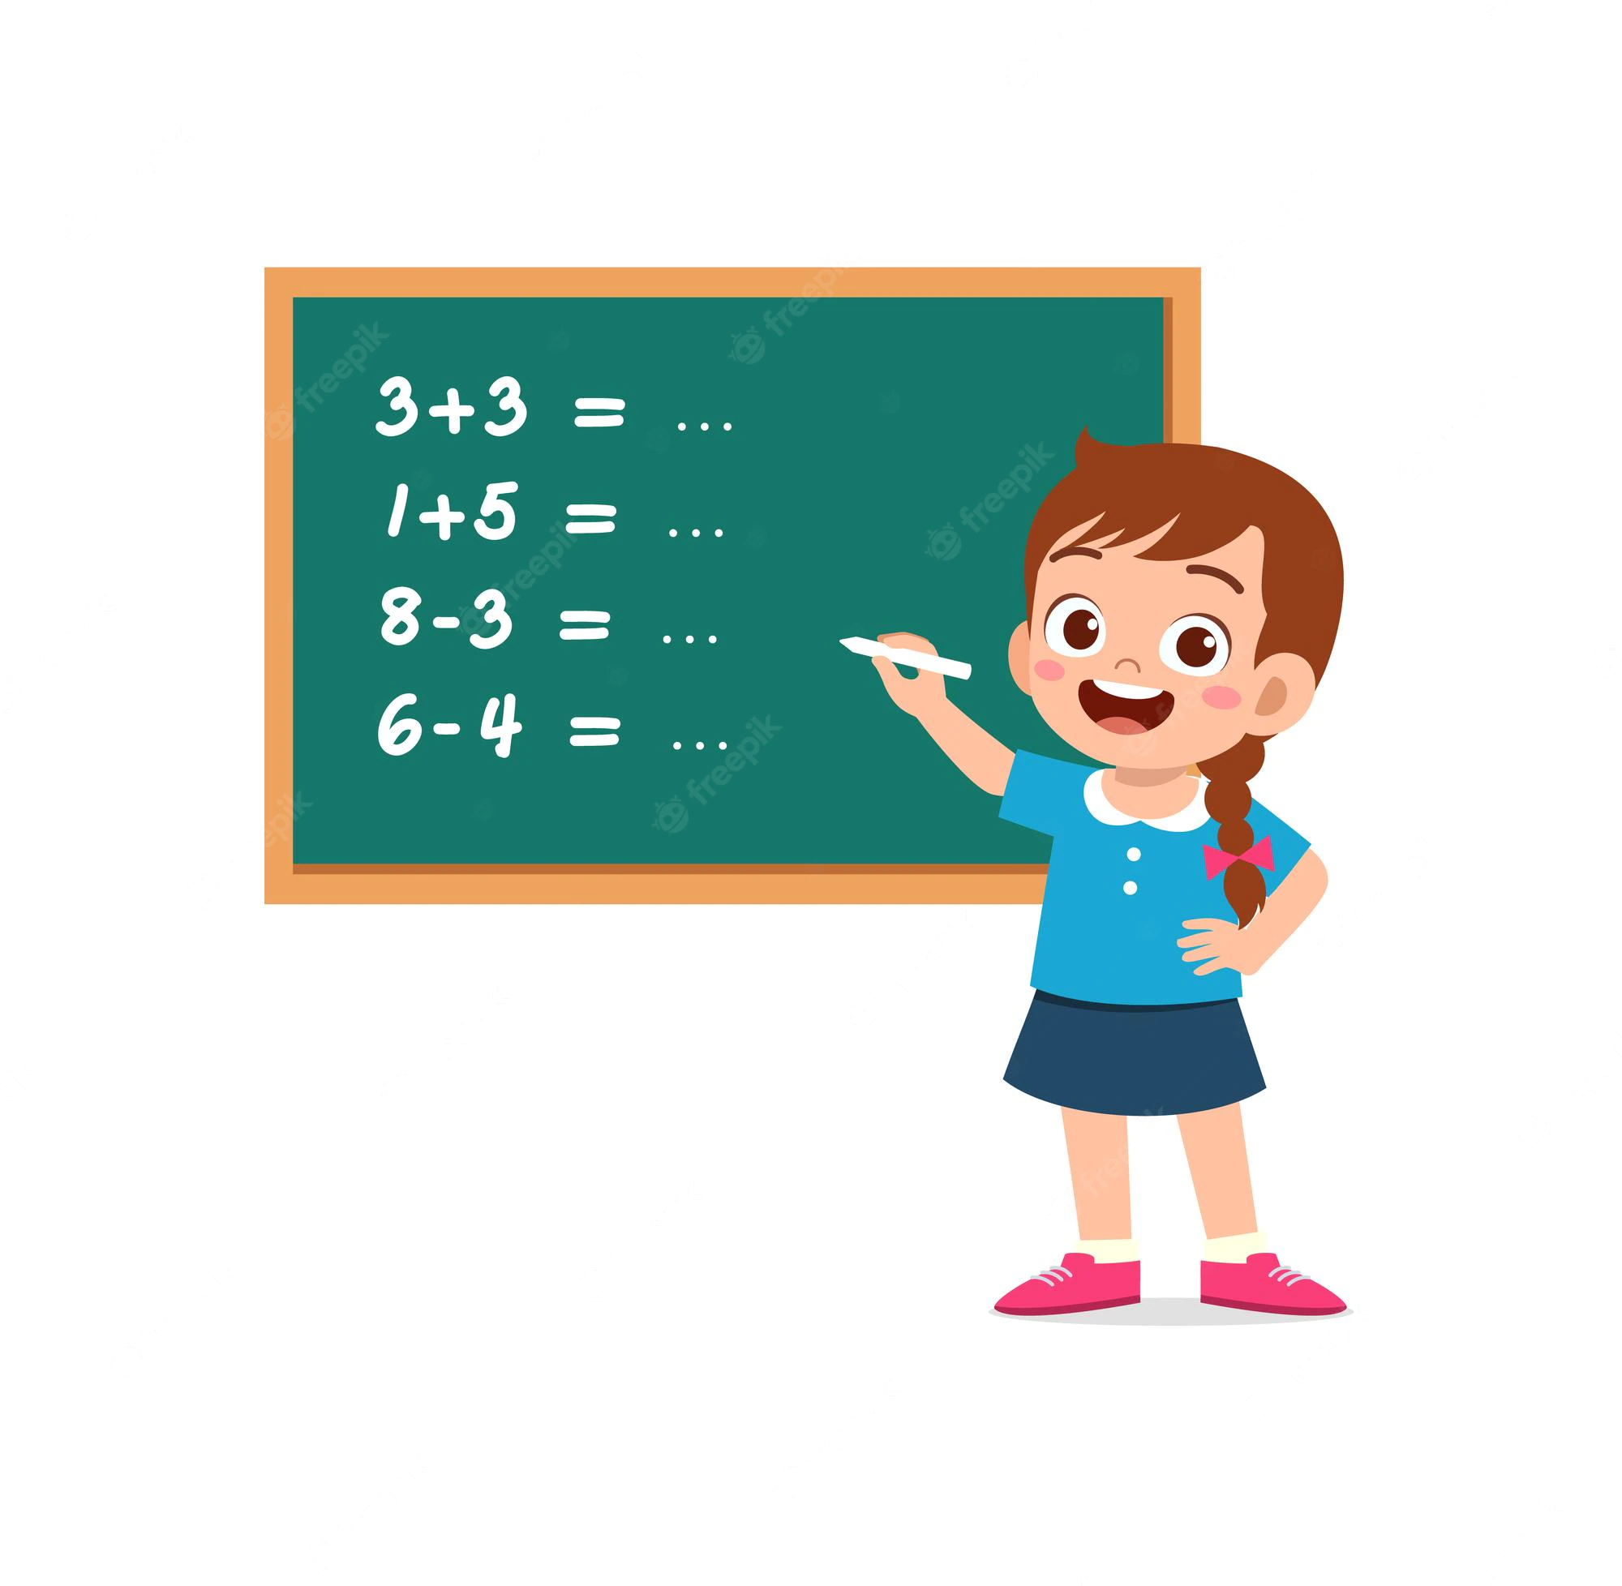
Practice – Multi-threading
Multi-threading
LeetCode 1117 - Building H2O - Link

Slide 4
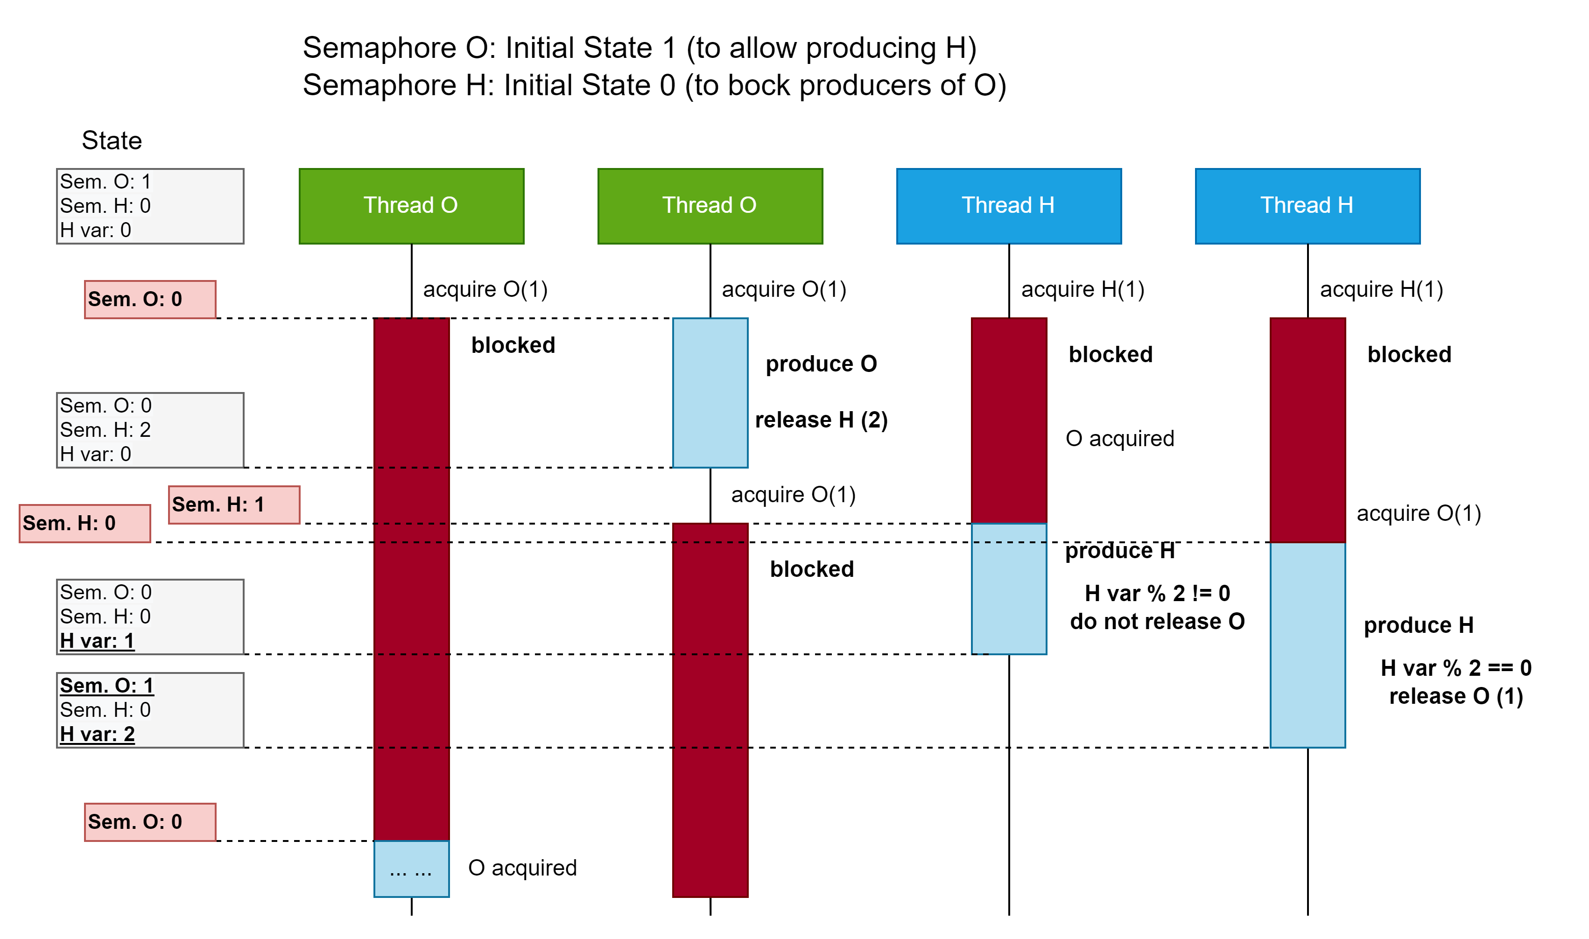
Practice – Multi-threading – Building H2O

Slide 5
Practice – Warming-Up – Hash Structures 1
Just warming-up on hash structures
LeetCode 0217 – Contains Duplicate – Link

Slide 6
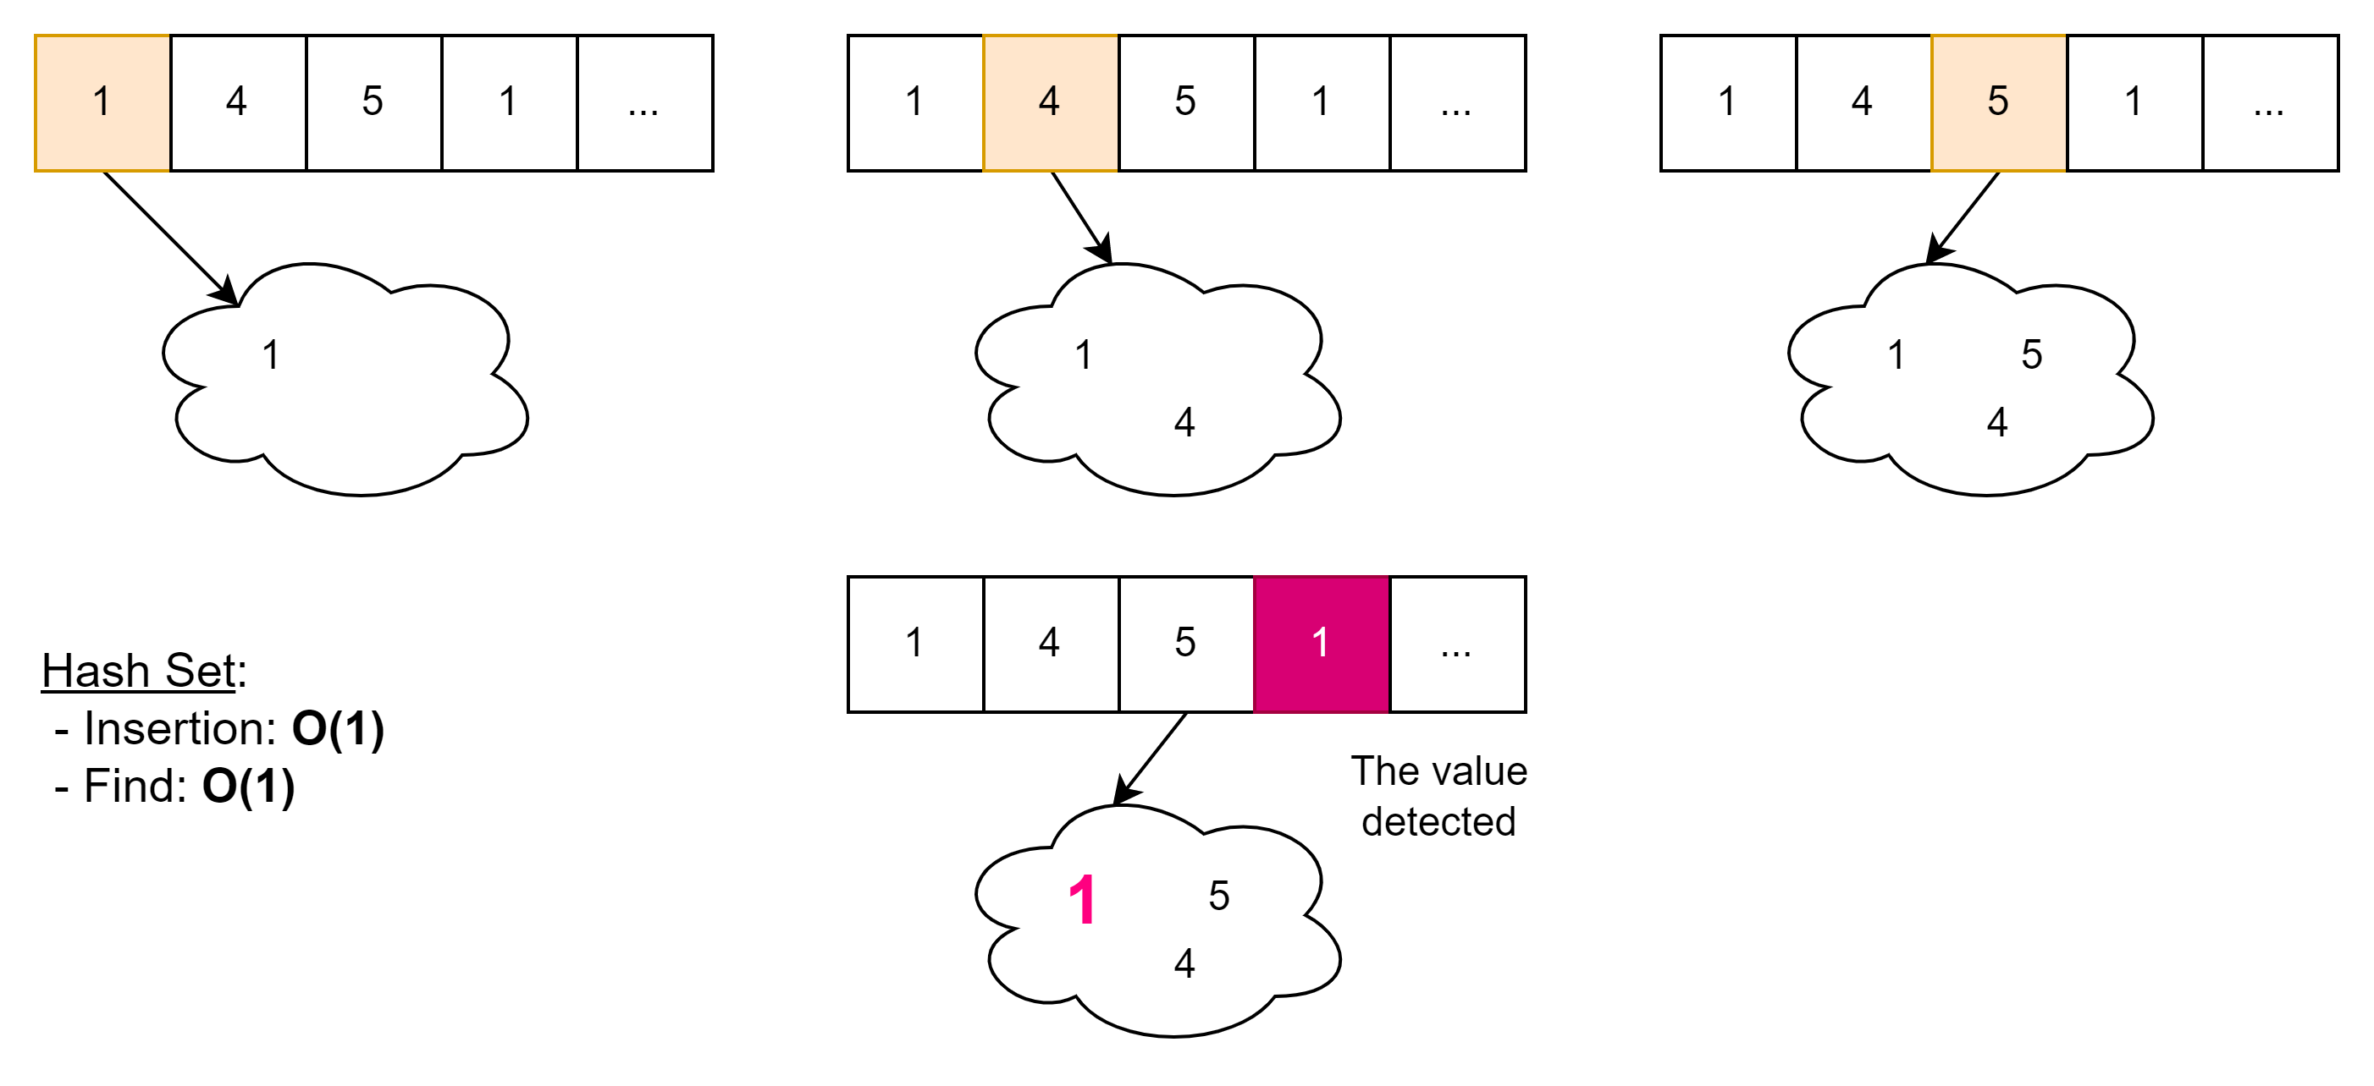
Practice – Warming-Up – Hash Structures 1
Just warming-up on hash structures
LeetCode 0217 – Contains Duplicate – Link

Slide 7
Practice – Warming-Up – Hash Structures 2
Just warming-up on hash structures
LeetCode 0219 – Contains Duplicate II – Link

Slide 8
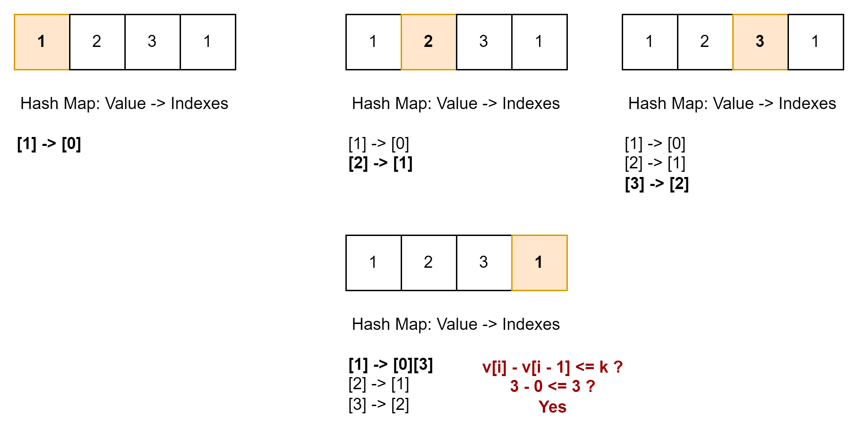
Practice – Warming-Up – Hash Structures 2
Just warming-up on hash structures
LeetCode 0219 – Contains Duplicate II – Link

Slide 9
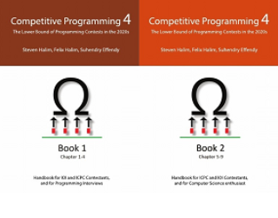
How to Learn and Practice
As one of the recommendation is to use:
Book Competitive Programming 4
Kattis – Link
Online Judge – Link
Few Theory
A Lot of Practice
A Lot of Theory
Almost No Practice

